Slide 1

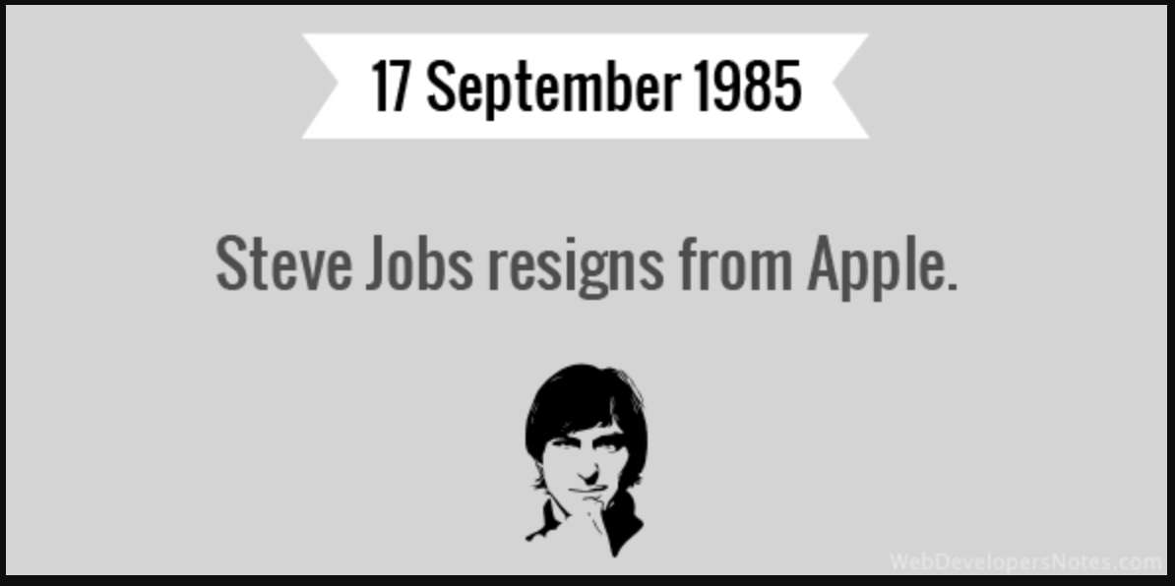
Notes:
First Paragraph:
In 1985 CEO Steve Job left Apple.
Apple went into a decade-long downward spiral. Sales continued to plummet, almost reaching bankruptcy.
Jobs eventually returned to Apple in 1997 after a series of calculated moves.
Jobs changed the course of Apple by simplifying things.
He put an end to the feuds and took an unheard-of level of interest in the details of product development.
Over the following two decades, he was the driving force behind some of this century’s most significant technological breakthroughs.
With groundbreaking products like iTunes Music Store, the iPod, the iPhone, and the iPad, among others, Jobs presided over an unprecedented period of growth.
Nearly a decade after his death, Job's legacy continues.
As of Now, Apple has a market cap of $2.4T, and it easily ranks among the top of the Forbes list as the most valuable brand in the world.
Foods and Stuff at the moment is a powerful asset to this company, however there are simple calculated moves that are needed to be done to take this business to the next level.
In class notes:
Do’s
Something +
Use strong Verbs
Compliment the Audience
Refer to current events
Refer to historical events
Make a shocking statement (70)
Quote from recent research
Be careful with Humor
Show Participation
Open with a problem
Start with a bridge:
Connect from you to the audience
Half and Half Story
Make your first and last impression the strongest points
Your first and last three minutes are your strong points
Don’ts

Slide 2
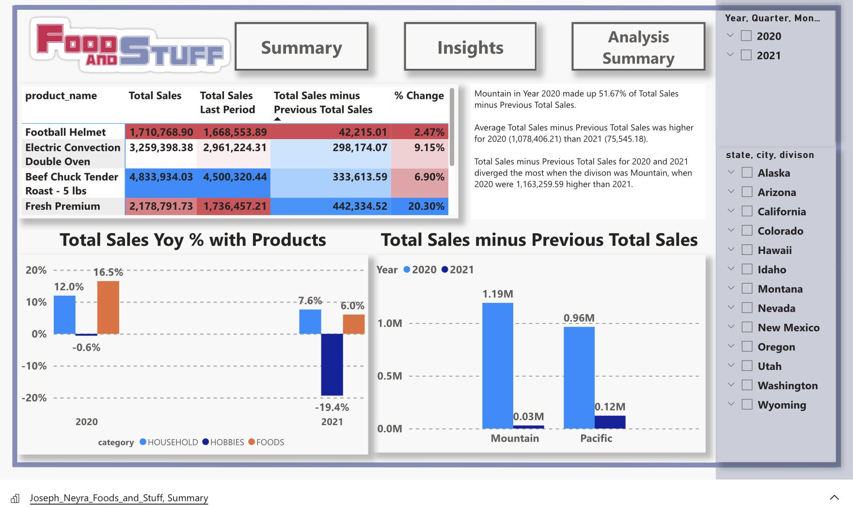
Notes:
7.6 Household
-19.4 Hobbies
6.0 Foods
Summary:
Annotations Ruby wanted to see
Insight:
Things I feel like we needed to see
Analysis Summary:
Here we can see what went right, What went wrong, and how we can fix this.
Pearl 1:
Yoy% growth in certain states
Pearl 2:
What been our biggest sale
What went wrong?:
Explain over the year a significate drop in Outdoors
Price or Quantity?:
Explain how a drop in price with quantity to sustain the blow has made a big mark on the stats
Option 1: by removing Outdoor and Living room department we go from our lowest -106k range to – 69k , a 131 difference. Highest going from 50.45 to 74
Option 1%: Change in Percentage
Option 2: by removing St. George, we went from -106 to -45 with a constant in High sales
Option 2%: Change in Percentage
Option 3: by removing ST. George, Outdoor, and Living room, our lowest sale drops to -26k and rises to 73.61k
Option 3%: Change in Percentage

Slide 3
Notes:
Conclusion:
By hauling the Outdoor, Living Room, and St. George, sale % will increase and we will be able to get over this drought.
“If you don't build your dream, someone else will hire you to help them build theirs.” — Dhirubhai
if you take Ruby away from on this board, she will build your dreams.
I know if you let us reform this business, it will be a unique asset to this board.
Thank You

